Slide 1

Advanced Cloud Features
IST 615

Slide 2
Advanced Features
Enhancing the IT infrastructure basics of
Networking
Azure dark fiber
Wavelengh
Storage
Snowmobile
Silica
ScutIO
Compute
FPGA
New Practical applications of information technologies
Blockchain
Sphere

Slide 3
Advanced Features – Why?
Why is are the Advanced Feature in the Public Cloud?
What is the vendor trying to gain by offering this feature?
How might a customer use the feature in their own product or offering?

Slide 4
Azure Networking
Azure Under-Sea cables
https://www.businesswire.com/news/home/20190225005955/en/
https://news.microsoft.com/marea/
https://blogs.microsoft.com/blog/2017/09/21/celebrating-completion-advanced-subsea-cable-across-atlantic/?ranMID=24542&ranEAID=je6NUbpObpQ&ranSiteID=je6NUbpObpQ-X1qBBcNqVc15MhN5aliPSA&tduid=(0d7be23eda94de406c1717184d3c82de)(256380)(2459594)(je6NUbpObpQ-X1qBBcNqVc15MhN5aliPSA)()
https://youtu.be/XwbzTpLGJ9M
Azure dark fiber
https://youtu.be/X-0V6bYfTpA?t=288
Why do they need their own cables?
Notes:
Video 1 – 1:40
Video 2 – start to 6:02

Slide 5
AWS Wavelength
AWS Wavelength brings AWS services to the edge of the 5G network, minimizing the latency to connect to an application from a mobile device. Application traffic can reach application servers running in Wavelength Zones without leaving the mobile provider’s network.
https://aws.amazon.com/wavelength/
https://www.youtube.com/watch?v=ha6duyoEPJc
What could a company do with having high throughput and low latency mobile computing?
Notes:
Video 1: Start to 9:00

Slide 6
AWS Snowmobile
AWS Snowmobile is an Exabyte-scale data transfer service used to move extremely large amounts of data to AWS
https://aws.amazon.com/snowmobile/
https://www.youtube.com/watch?v=8vQmTZTq7nw
What do we think happens when it gets back to AWS Data Center?
Notes:
Video: Start to 3:38
Exabyte = 1,000,000 Terabytes.

Slide 7
Azure Project Silica
The demand for long-term data storage is reaching unprecedented levels. With an accelerating growth trend we expect that the data stored in the cloud will soon reach the zettabyte mark, but the capacity of existing storage media is not keeping up.
https://www.microsoft.com/en-us/research/project/project-silica/
https://youtu.be/sOw8On1iCa4?t=3675
Notes:
Video: Start to 1:03:50
~3 mins

Slide 8
Azure SCUTIO
Extremely Fast storage capabilites
With up to 1,000 times lower latency and exponentially greater endurance than NAND, 3D XPoint technology can deliver game-changing performance for big data applications and transactional workloads.
https://www.micron.com/products/advanced-solutions/3d-xpoint-technology
https://youtu.be/X-0V6bYfTpA?t=1047
How does faster storage help Cloud customers?
Notes:
17:24 to 20:30

Slide 9

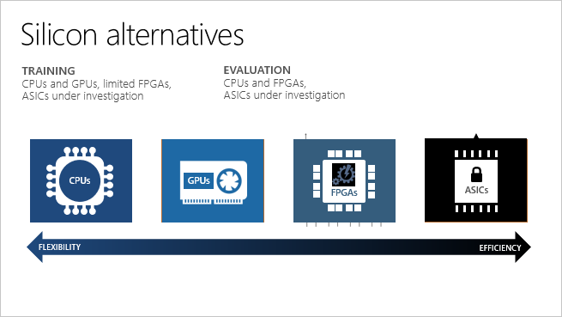
Azure – FPGA
FPGAs contain an array of programmable logic blocks, and a hierarchy of reconfigurable interconnects. The interconnects allow these blocks to be configured in various ways after manufacturing. Compared to other chips, FPGAs provide a combination of programmability and performance.
https://www.youtube.com/watch?v=Oi0XLs9t4-8
https://youtu.be/v_4Ap1bjwgs?t=392
Notes:
Video1: 1:55
Video2: 6:30 to 12:00

Slide 10
AWS Blockchain
“Blockchain technologies are often used to solve two types of customer needs. In the first case, multiple parties work with a centralized, trusted authority to maintain a complete and verifiable record of transactions”
https://aws.amazon.com/blockchain/
https://www.youtube.com/watch?v=9xbtq362Scs
https://corporate.walmart.com/newsroom/2018/09/24/in-wake-of-romaine-e-coli-scare-walmart-deploys-blockchain-to-track-leafy-greens
https://youtu.be/CYJILzRKJmQ
https://youtu.be/js5CPfK1hCQ
Other uses that we can think of?
Notes:
Video1: 1:52
Video2: 1:11
Video3 1:51

Slide 11
Azure Sphere - IoT
“It’s built on decades of Microsoft experience in hardware, software, and cloud to provide a turnkey security solution for IoT devices”
https://azure.microsoft.com/en-us/services/azure-sphere/#overview
https://www.youtube.com/watch?v=iiDF26HNh-Y
What kinds of products do we think might soon have these microcontrollers?
Notes:
Video1: 2:14

Slide 12

Azure – AI
AI is the capability of a machine to imitate intelligent human behavior. Through AI, machines can analyze images, comprehend speech, interact in natural ways and make predictions using data.
https://azure.microsoft.com/en-us/overview/ai-platform/
https://youtu.be/wo9XqYSuBdc
Notes:
Video 6:28

Slide 13
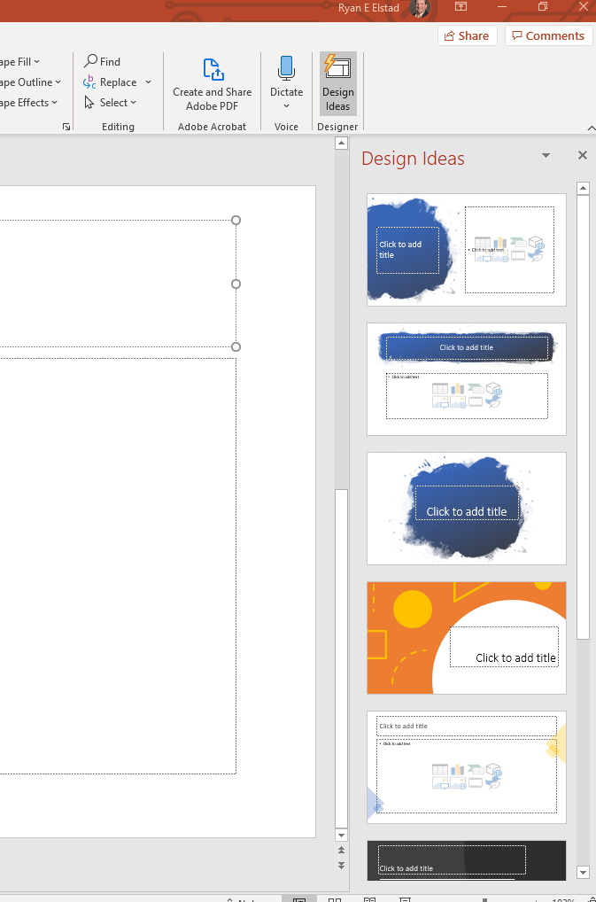

Slide 14
Class Participation Assignment
Choose an advanced cloud feature and answer the following question in a few sentences.
Be creative! No right or wrong answer.
How might EV use the feature to enhance its streaming video product offering or what new feature might EV be able to create using one of the features?

